Slide 1
HANDWRITTEN CHARACTER RECOGNITION

Slide 2
Group Members
S.No | Name
1. | Kurapati Sarayu
2. | Surya Narayana Pasumarthi
3. | Gangam Rushik Reddy
4. | Kandepu Naga RaviTeja

Slide 3
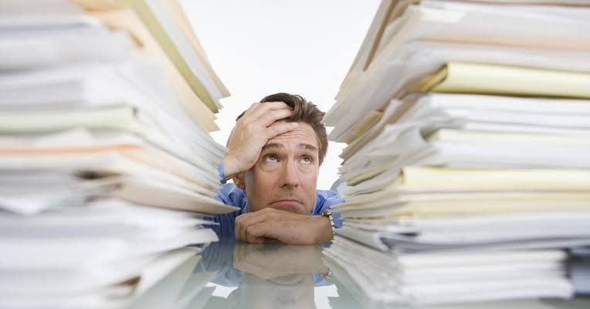
Introduction
Character recognition is a process which allows computers to recognize written or printed characters such as numbers or letters and to change them into a form that the computer can use.
Handling large amount of manual files are not an easy task, the room full of document that are very important and may be necessary to be looked into any time. This intuition helps us realize the necessity of a character recognition library in every office.

Slide 4
Objective
To convert the handwritten text into an editable digital format for deeper and further processing.
To extract the information contained in the text file or an image.

Slide 5
Work Done
Created a model to recognize the handwritten text.
Developed a model to predict the accuracy

Slide 6
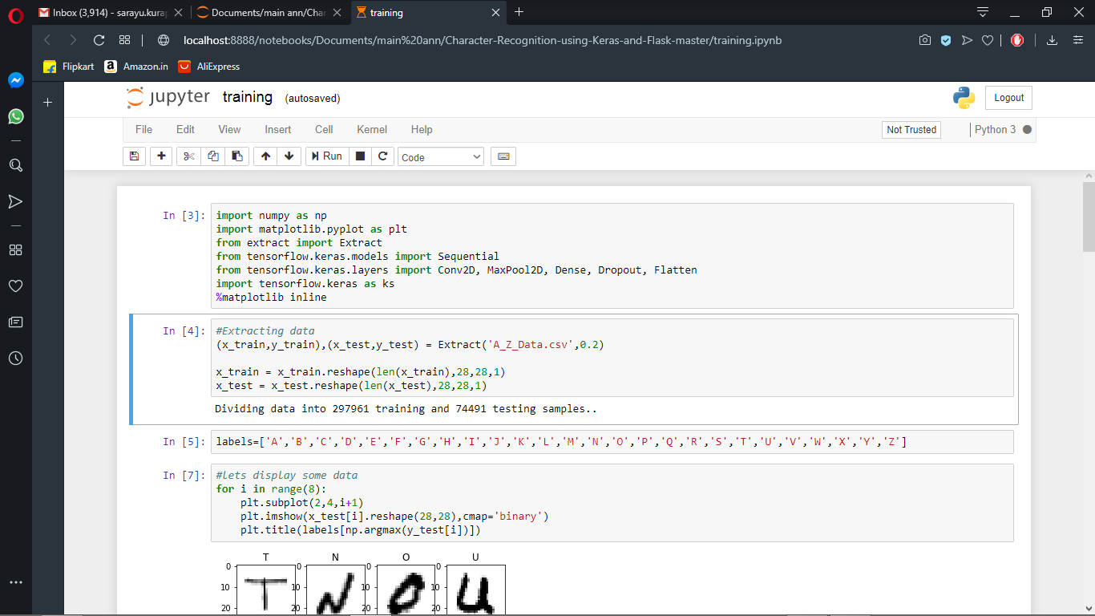
Screenshots of work done

Slide 7
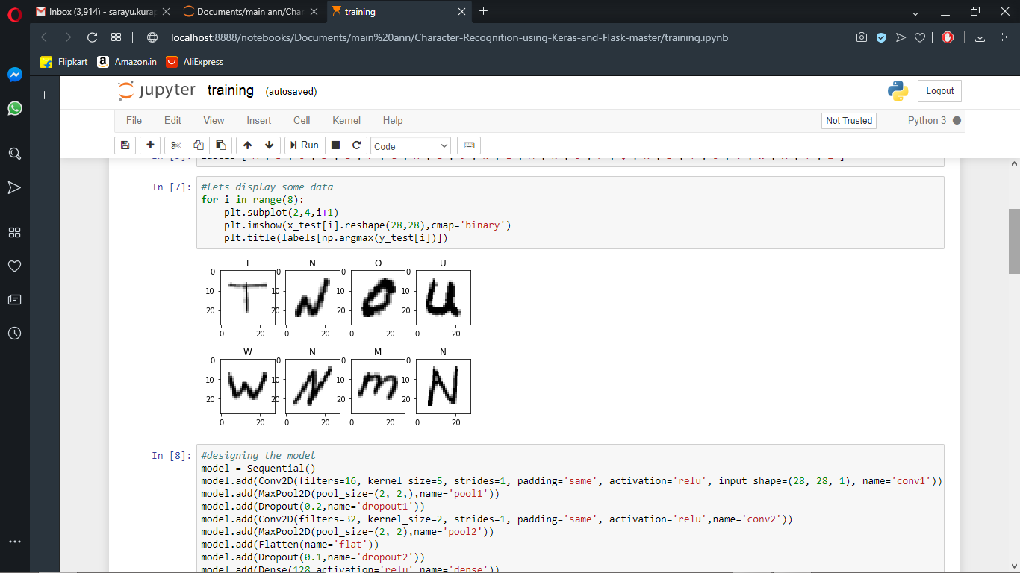
Displaying data

Slide 8
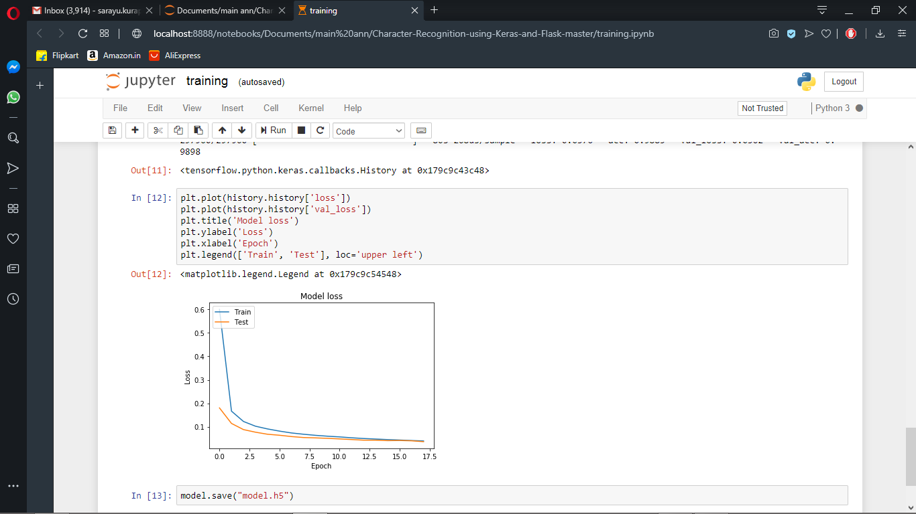
Plotting loss curve vs epoch

Slide 9
Applications
Banking: OCR application is in banking, where OCR is used to process checks without human involvement. A check can be inserted into a machine, the writing on it is scanned instantly, and the correct amount of money is transferred.
HealthCare: To keep up with all of the information regarding patients and their insurance forms, it is useful to input relevant data into an electronic database that can be accessed as necessary.
In airports, for passport recognition and information extraction
Automatic insurance documents key information extraction
Extracting business card information into a contact list

Slide 10
Roles and Responsibilities
Name | Roles
Kurapati Sarayu | Training model
Surya Narayana pasumarthi | Extracting data
Gangam Rushik Reddy | Accuracy prediction
Naga RaviTeja | Accuracy prediction

Slide 11
Conclusion
We learnt the structure behind identification of physical writing characters and building a python library function. The span of this project involved functions i.e. acquisition of images, selection of characters, categorization, pre-processing process, and creation of outcomes.

Slide 12
THANK YOU

